Slide 1
ML for Selecting Electrolytes
“SELEC” User Interface
02/24/2022
Bella Wu
Karen Li
Rose Lee
Shuyan Zhao
Notes:
names → UI → ML

Slide 2
Project Motivation
Electrolyte research is a hot topic
Input combination of 3 variables (cathode, anode, C-rate)
Program predicts battery performance and selects best electrolyte
Cathode
Electrolyte
Anode
Notes:
battery eli5 → program fn → audience is rnd

Slide 3

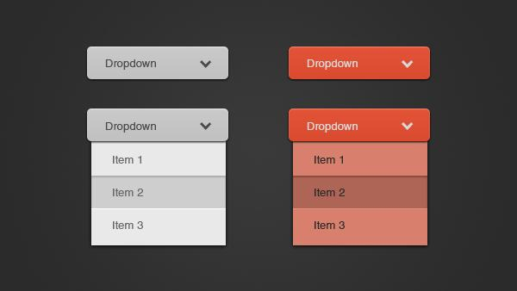

Need for User Interface
Not everyone knows Python
Notes:
audience is rnd → python scary uwu → ez interface

Slide 4




Packages Considered
Web Interfaces
Graphical User Interfaces
Tkinter
Notes:
Tkinter, Pyqt, kivy
https://www.geeksforgeeks.org/python-gui-pyqt-vs-tkinter/
https://www.educba.com/kivy-vs-tkinter/
https://redhuli.io/create-ui-with-tkinter-grid-layout-manager/
https://www.geeksforgeeks.org/what-does-the-tearoff-attribute-do-in-a-tkinter-menu/

Slide 5
Packages Considered
Tkinter
Advantage
Coding versatility
Various UI components
Various learning resources
Disadvantage
Lack of Python classes
Time consuming
Source issue (open vs. non-open)
Advantage
Easy and fast to implement
More flexible and stable
Simple syntax
Easy to understand and master
Disadvantage
Does not include advanced widgets
No reliable UI
Can be hard to debug
Advantage
Fine geometry management
Support various platform
Disadvantage
Additional installation
Widgets problem on naming parameters

Slide 6
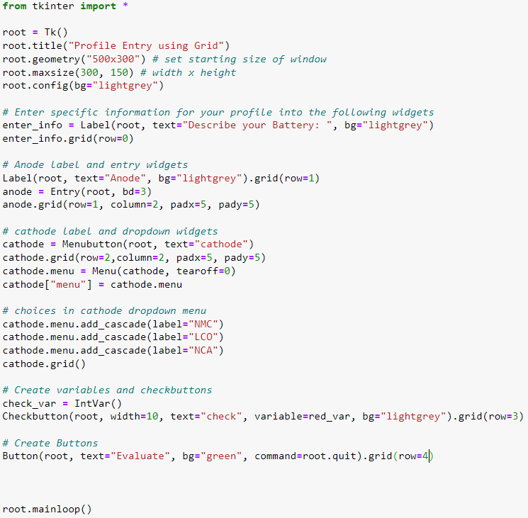
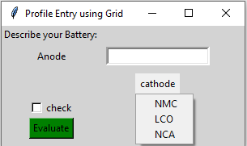
Tkinter

Slide 7
Tkinter Advantages and Disadvantages
Pros
Open source
Tkinter package already loaded in python
Relatively simplistic and easy to understand
Cons
Older looking interface
Lack of advanced widgets
Still need to open python to start user interface

